Slide 1
Calculating the mode
Numerical summaries of data

Slide 2
how to use Oak lessons

Slide 3
I can calculate the mode from data presented in a frequency table and different graphs.

Slide 4
frequency
mode

Slide 5
The frequency is the number of times an event occurs; or the number of individuals (people, animals etc.) with some specific property.
The mode is the most frequent value. It is a measure of central tendency representing the average of the values.

Slide 6

Calculating the mode
Mode from a frequency table
Mode from bar charts
Mode from line graphs

Slide 7
Mode from a frequency table
12, 12, 13, 14, 14, 14, 14, 14, 14, 15, 15
In this list of data is it clear to see that 14 appears more than any other value. The mode is 14.
Score | Frequency
12 | 2
13 | 1
14 | 6
15 | 2
When presented as a frequency table, it can be less clear.

Slide 8
Mode from a frequency table
This frequency table shows the colours of pet collars.
Colour | Frequency
red | 18
blue | 21
green | 18
yellow | 21
other | 17
The highest frequency is 21.
It appears twice, so the data is bimodal.
The modal colours are blue and yellow.

Slide 9
Mode from a frequency table
What is the mode for each frequency table? If there is no mode, write no mode.
Animal | Frequency
cat | 24
dog | 18
fish | 11
rabbit | 15
Goals | Frequency
0 | 16
1 | 24
2 | 24
3 | 19
Score | Frequency
1 | 12
2 | 12
3 | 12
4 | 12

Slide 10
Mode from a frequency table
A data set of 50 is represented on this frequency table.
Fill in the missing frequency and write down the mode number of goals scored.
Goals | Frequency
0 | 9
1
2 | 11
3 | 21

Slide 11
Mode from a frequency table
What is the mode for each frequency table? If there is no mode, write no mode.
Animal | Frequency
cat | 24
dog | 18
fish | 11
rabbit | 15
Goals | Frequency
0 | 16
1 | 24
2 | 24
3 | 19
Score | Frequency
1 | 12
2 | 12
3 | 12
4 | 12
cat
1 and 2 goals
no mode

Slide 12
Mode from a frequency table
A data set of 50 is represented on this frequency table.
Fill in the missing frequency and write down the mode number of goals scored.
Goals | Frequency
0 | 9
1
2 | 11
3 | 21
9
3 goals scored

Slide 13
Calculating the mode
Mode from a frequency table
Mode from bar charts
Mode from line graphs

Slide 14
Mode from bar charts
Scores for a game have been collected and are shown in the frequency table.
This frequency table shows that the mode score is 0. It has the greatest frequency.
Score | Frequency
0 | 45
1 | 37
2 | 29
3 | 31
4 | 31
5 | 27
There are two scores with the same frequency, but they are not the greatest so it isn’t bimodal.

Slide 15
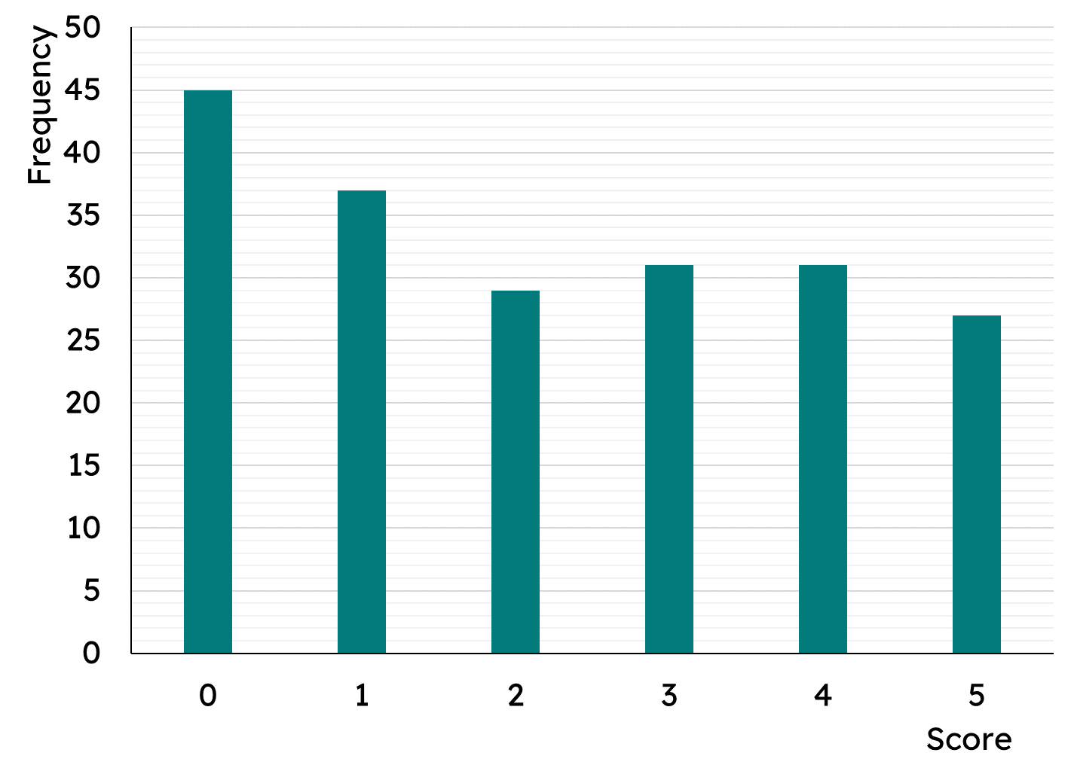
Mode from bar charts
Just like the frequency table, where you identify the greatest frequency; in a bar chart you identify the tallest bar(s).
This bar is the tallest; the mode score is 0.
There are two bars of the same height, but they are not the tallest, so it isn’t bimodal.

Slide 16

Mode from bar charts
On a bar chart, the mode is …
the most frequent height.
The mode is about the context of the data.
The frequency indicates which it is.
the frequency of the tallest bar.
the context of the tallest bar.

Slide 17

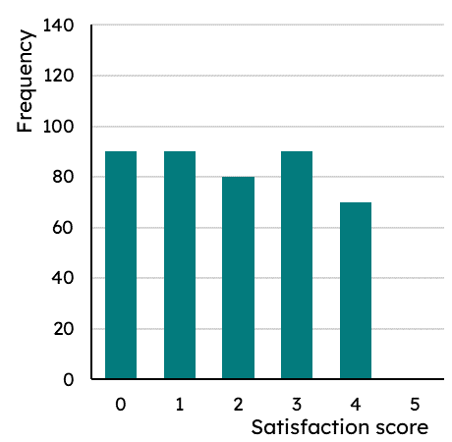
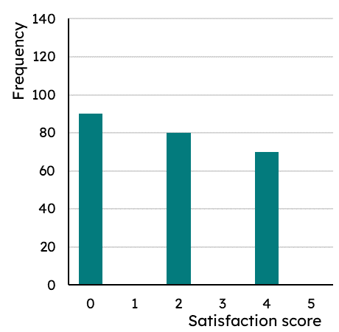
Mode from bar charts
Laura’s homework is to complete a bar chart.
The task tells her that the data is trimodal and there are 600 pieces of data. The bars 1, 3 and 5 are missing.
Laura remembers that trimodal means there will be three of the tallest bars.
But which is the tallest?
The 0 bar has the greatest frequency of 90. So three bars of heights 90.

Slide 18
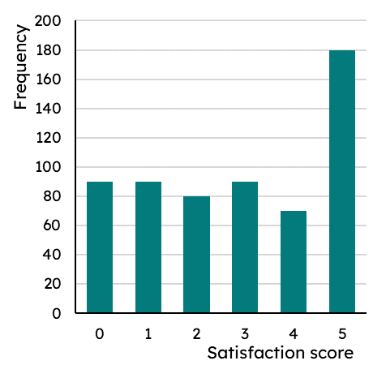
Mode from bar charts
Laura’s homework is to complete a bar chart.
The task tells her that the data is trimodal and there are 600 pieces of data. The bars 1, 3 and 5 are missing.
There needs to be a total frequency of 600.
Currently there is a frequency total of 90 + 90 + 80 + 90 + 70 = 420
Which means the score 5 bar will need to have a frequency of 180.

Slide 19
Mode from bar charts
Laura’s homework is to complete a bar chart.
The task tells her that the data is trimodal and there are 600 pieces of data. The bars 1, 3 and 5 are missing.
The data is no longer trimodal.

Slide 20
Mode from bar charts
Laura’s homework is to complete a bar chart.
The task tells her that the data is trimodal and there are 600 pieces of data. The bars 1, 3 and 5 are missing.
Laura decides to start with the total frequency.
Currently there is a frequency total of 90 + 80 + 70 = 240
Which means the other three bars need a total of 360.

Slide 21
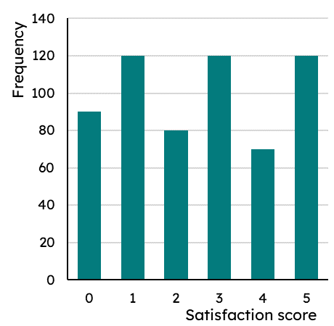
Mode from bar charts
Laura’s homework is to complete a bar chart.
The task tells her that the data is trimodal and there are 600 pieces of data. The bars 1, 3 and 5 are missing.
The data is also trimodal, so the three bars need to be equal heights and taller than the other three.
360 ÷ 3 = 120
Laura has completed her homework.

Slide 22

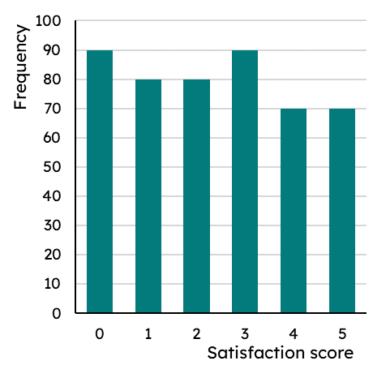
Mode from bar charts
Izzy has the same homework task and submits this.
Why is it incorrect?
It doesn’t have a total frequency of 600.
It has three pairs of equal bars, but that isn’t the definition of trimodal.

Slide 23
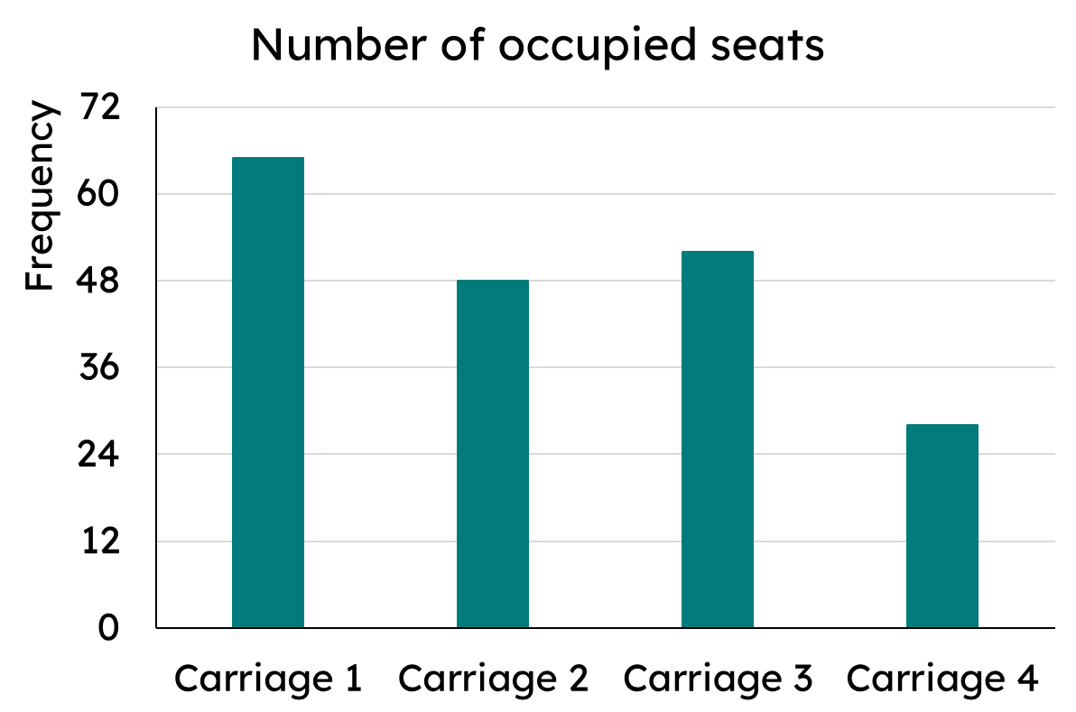
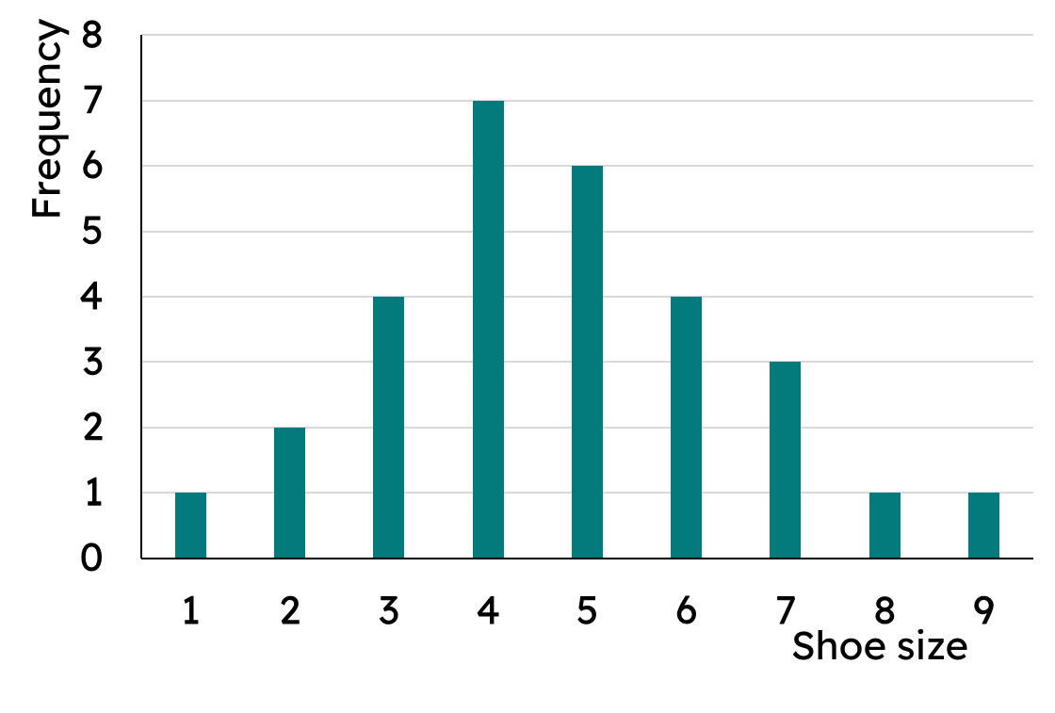
Mode from bar charts
What is the mode on each of these bar charts?
a)
b)

Slide 24
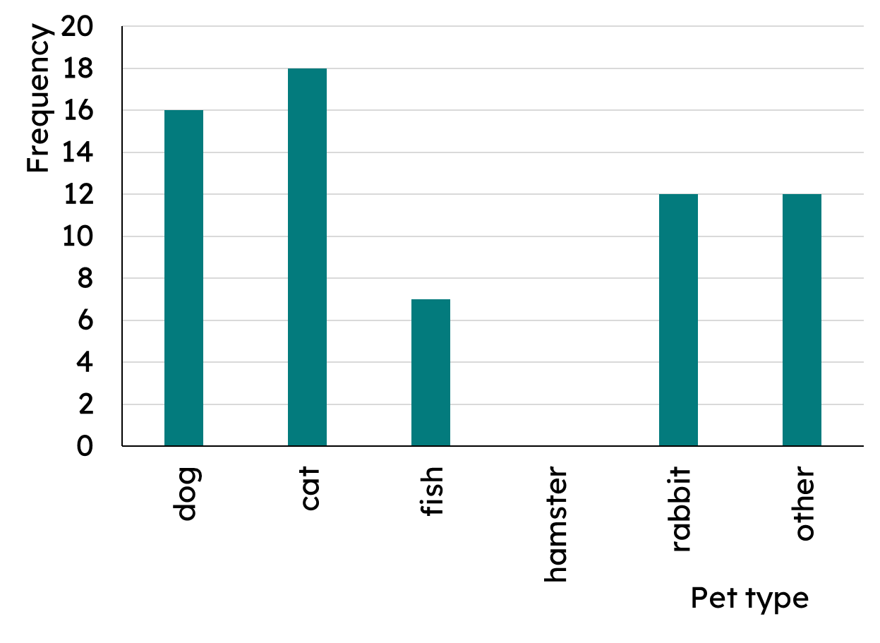
Mode from bar charts
The data is bimodal. Complete the bar chart.

Slide 25
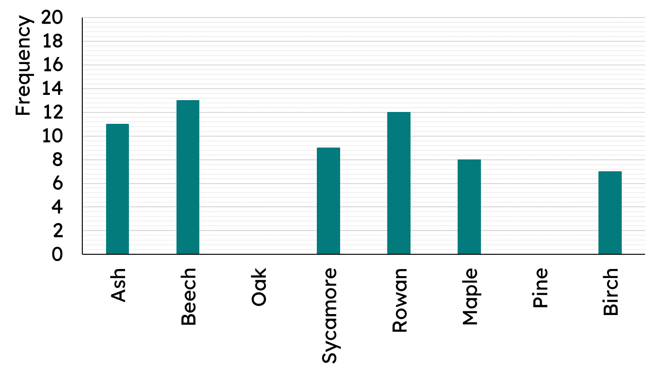
Mode from bar charts
100 pieces of data are represented on a bar chart. The data is bimodal. Add the two missing bars.
Types of tree

Slide 26
Mode from bar charts
What is the mode on each of these bar charts?
a)
b)
Carriage 1
Size 4

Slide 27
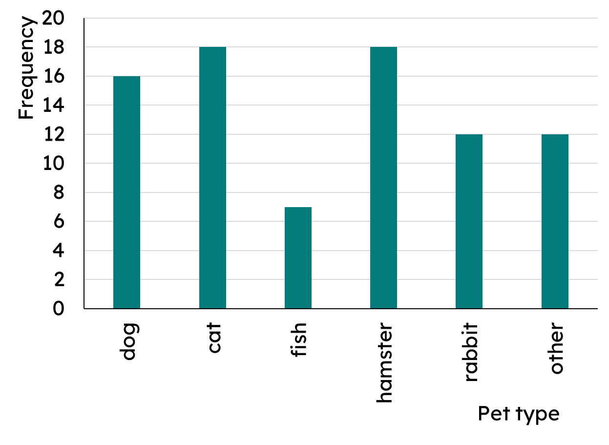
Mode from bar charts
The data is bimodal. Complete the bar chart.
Bimodal means it has two that appear the most, more than any others.

Slide 28
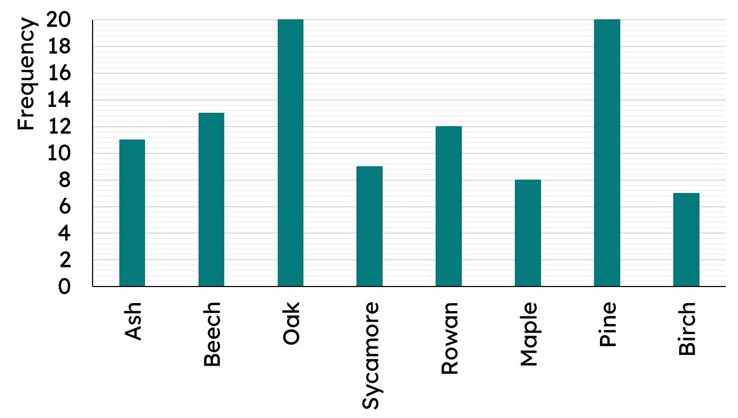
Mode from bar charts
100 pieces of data are represented on a bar chart. The data is bimodal. Add the two missing bars.
Types of tree

Slide 29
Calculating the mode
Mode from a frequency table
Mode from bar charts
Mode from line graphs

Slide 30
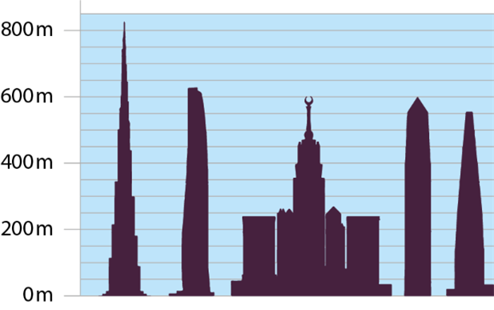
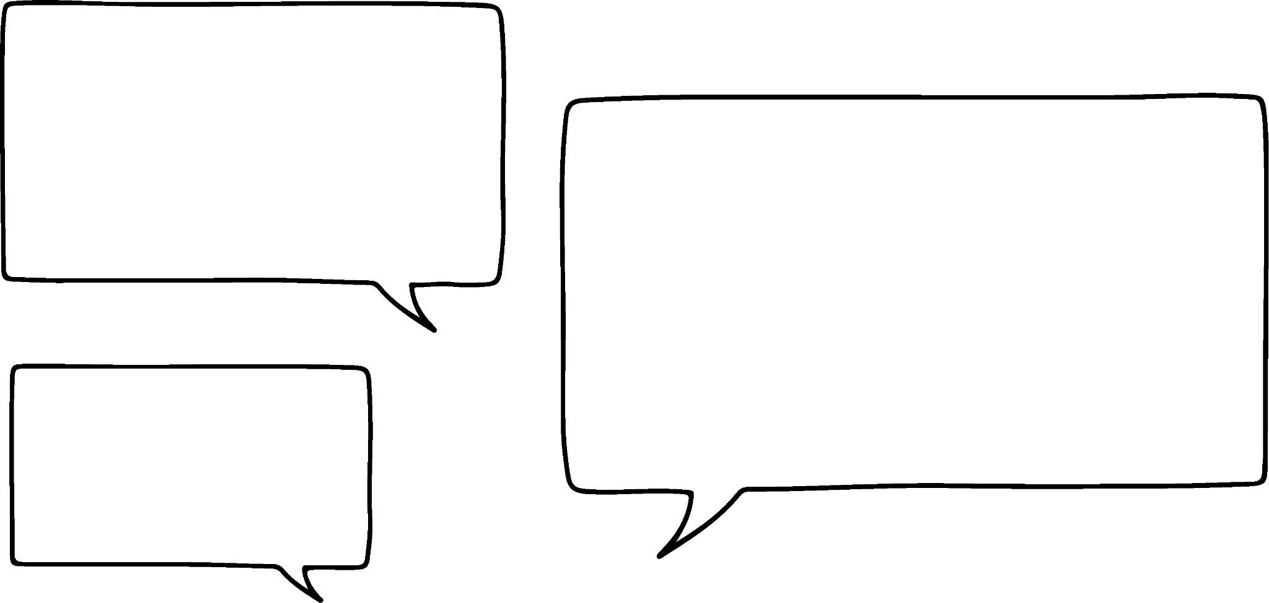

Mode from line graphs
The picture shows the five tallest buildings in the world.
What is the most common height?
The tallest so about 825 m.
C and D are the same height, so 600 m.
Izzy
A
B
C
D
E
The data is approximately 825 m, 625 m, 600 m, 600 m, 550 m
The mode would be 600 m as it appears more than any other value.
Sofia
Notes:
Image from NCETM Y8 Checkpoints Statistical representations: Checkpoint 13

Slide 31
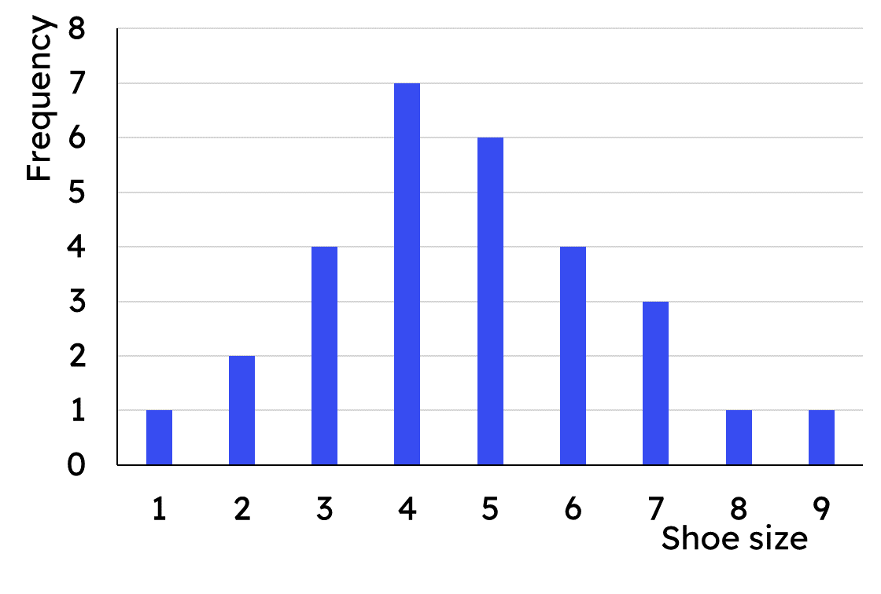
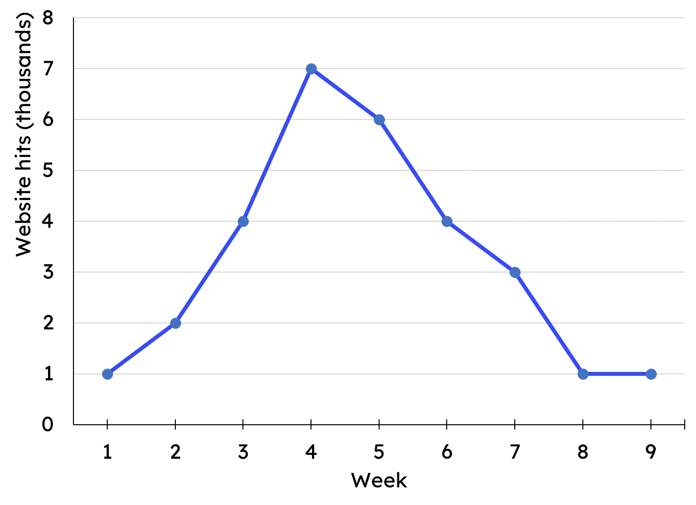
Mode from line graphs
Bar chart showing shoe sizes in a group of pupils
Line graph showing weekly hits on a website
The difference between the bar chart and the line graph is that the bars represent multiple pieces of data, whereas the line graph is a single value at each point.

Slide 32
Mode from line graphs
Bar chart showing shoe sizes in a group of pupils
Line graph showing weekly hits on a website
This means the mode is found differently. On the bar chart, it is the tallest bar(s).
Size 4 is the mode.

Slide 33
Mode from line graphs
Bar chart showing shoe sizes in a group of pupils
Line graph showing weekly hits on a website
This means the mode is found differently. On the line graph, it is the most points at the same horizontal value.
1000 hits is the mode.

Slide 34
Mode from line graphs
The mode on a line graph is the highest point.
The highest point is data with the most values.
The mode is the data value that appears the most.

Slide 35
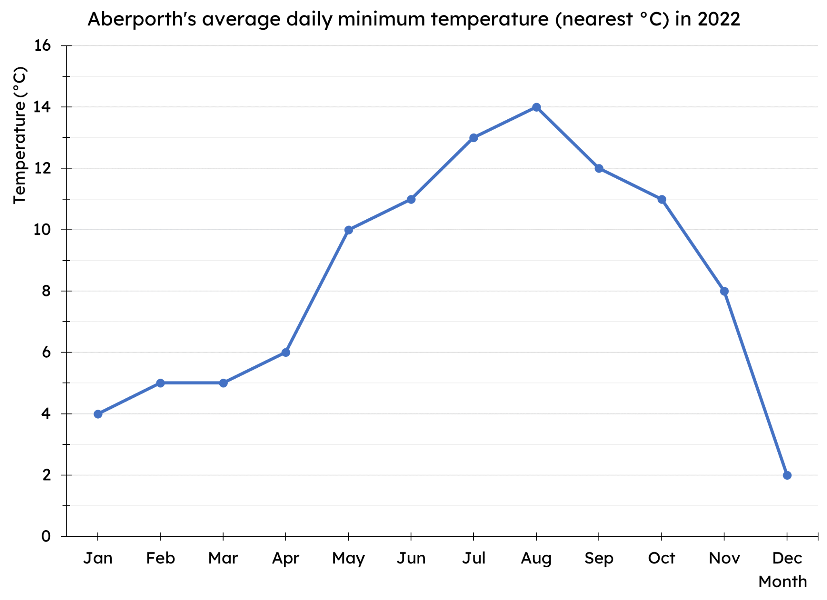
Mode from line graphs
What is Aberporth’s modal temperature in 2022?
By using a straight edge (i.e. ruler), you can move up the graph, counting the points on each horizontal line.

Slide 36
Mode from line graphs
What is Aberporth’s modal temperature in 2022?
2°C occurs 1 time

Slide 37
Mode from line graphs
What is Aberporth’s modal temperature in 2022?
4°C occurs 1 time

Slide 38
Mode from line graphs
What is Aberporth’s modal temperature in 2022?
5°C occurs 2 times

Slide 39
Mode from line graphs
What is Aberporth’s modal temperature in 2022?
If we continue in this way, we find that 5°C and 11°C both occurred 2 times, so they are both the modal temperatures.
The data is bimodal.

Slide 40
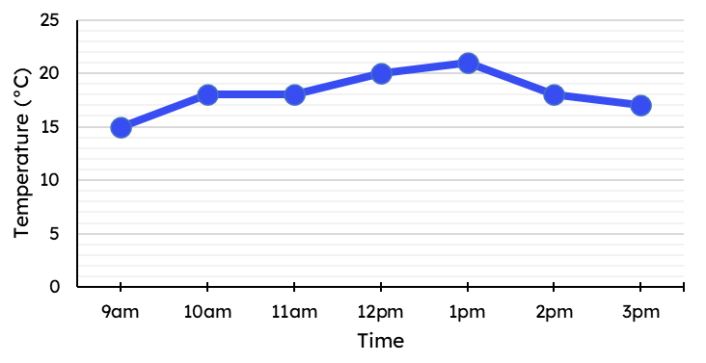
Mode from line graphs
What is the modal temperature in the classroom?
18°C

Slide 41
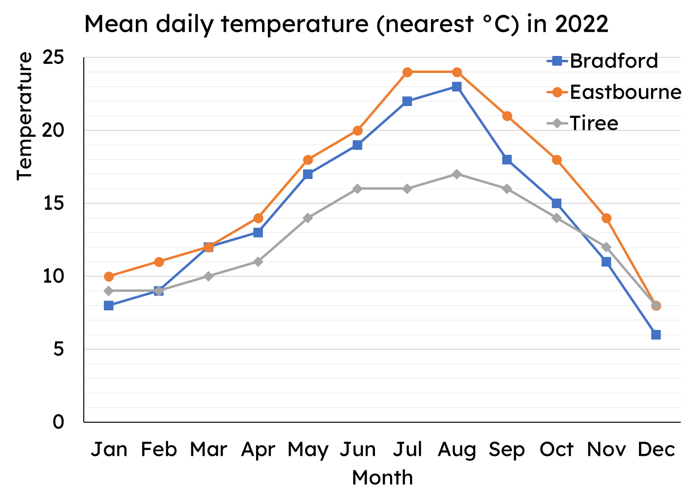
Mode from line graphs
What is the modal temperature for each place?

Slide 42
Mode from line graphs
What is the modal temperature for each place?
Bradford - no mode
Eastbourne - trimodal
14°C, 18°C and 24°C
Tiree - bimodal 9°C and 16°C

Slide 43
Calculating the mode
The mode can be found on a frequency table by looking for the greatest frequency.
The mode can be found on a bar chart by identifying the tallest bar.
The mode can be found on a line graph by identifying the horizontal with the most data points.

Slide 44

© Oak National Academy 2023.
Produced in partnership with Mathematics in Education and Industry.
Licensed on the Open Government Licence v3.0, except where otherwise stated. See Oak terms and conditions.

